Slide 1



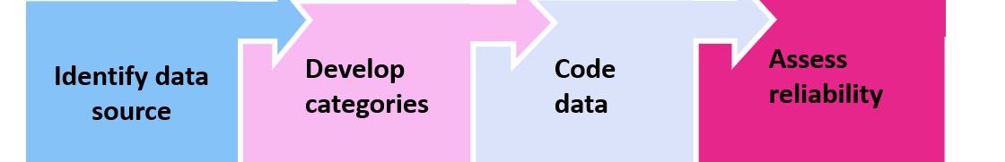
Women’s Sexual Concerns During and After Breast Cancer
Treatment Can Hinder Survivorship
Arielle Brutus¹, Smita Banerjee, PhD²
¹The City College, CUNY, NY, NY; ²Department of Psychiatry and Behavioral Sciences,
Memorial Sloan Kettering Cancer Center, NY, NY
Introduction
Results (n=100)
Conclusions
Sexual concerns are the third most reported concern of women during and after breast cancer (BC)
BC treatment modalities-chemotherapy, endocrine therapy, surgeries and radiation-may lead to side effects that negatively alter a woman’s sexual health/function.
Sexual dysfunction after BC treatment can result in significant emotional distress, lowered self-esteem, and relationship challenges
Sexual concerns are not often screened for or discussed, and women often turn to online resources for information
Reason for sharing | 98% Described
Asking if anyone else had similar experiences with (life/medication/side effects) | 34 (34%)
Catharsis (release of emotions, here to tell my story) | 16 (16%)
Recommend outside resource on sexuality/ cancer | 9 (9%)
Sexual concerns after BC treatment are frequent
Few women discuss sexual concerns with their health care providers during or after BC treatment
Women seek social support from other BC survivors on online forums
Aim
Treatment side effects | 82% Described
Decreased sexual desire | 14 (17%)
Body-image issues (self-image, feminity, sexiness) | 10 (12%)
Hot flashes | 9 (11%)
To examine the language and frequency that women’s sexual concerns are expressed during and after BC treatment, as shared on an online discussion board
Female Sexual Changes after Treatment
Vasomotor symptoms (hot flashes, flushing, night sweats)
Vaginal dryness/atrophy
Decreased libido
Dyspareunia (painful intercourse)
Arousal difficulties
Difficulty with orgasms
Stenosis (narrowing of the cervix)
Alternative relief | 14% Described
Lubricant | 3(21%)
Replens (estrogen free moisturizer) | 2 (14%)
Other_____ (estrogen therapy, lotion, flaxseed oil, pluck hair | 9 (64%)
Future Directions
Healthcare providers should inquire and address sexual concerns to enhance quality of survivorship
We recommend training for health care providers to create an open and safe environment for women to discuss sexual concerns during and after BC treatment
Methods
Communication with healthcare provider | 27% Described
Provider prescribes something to relieve symptoms | 6 (22%)
Describes negative or unhelpful interaction | 5 (18.5%)
Provider referred patient to specialist | 2 (7%)
Acknowledgments
The sample included 100 discussions posted on the American Cancer Society Website discussion board
The content analysis categories were determined based on inductive coding, whereby we developed coding categories directly from a sub-set of the data
Dr. Smita Banerjee, Dr. Laura Liberman, and Melissa Marshall Department of Psychiatry and Behavioral Sciences, Memorial Sloan Kettering Cancer Center, NY, NY
Notes:
Hello my name
My poster is titled
3rd leading cause of death but survivorship increased 31 % in last 10
Among survivors sexual concern
Why patient feel unconftable and hope their clincians will bring it up

